Slide 1

How to Develop Secure Applications: The BadgeApp Example
David A. Wheeler
dwheeler @ ida.org
2017-09-18

Slide 2

The need
Computer systems everywhere are under attack
If you develop software, must make it secure
How? What does that mean?
Notes:
First, the need.
Computer systems are under attack. Just look at the news, every day there’s a new successful attack against some computer system.
This means that if you are involved in developing software, then you must make it secure. That includes software developers, testers, and their managers too.
But HOW do you develop secure software? What does that even mean? A big problem today is that many colleges and universities do not teach developers how to develop secure software. Even if they do, it’s often an optional class. In addition, many software developers didn’t go to a college or university to learn their craft. As a result, a lot of developers are unprepared to deal with the world as it exists today. Many software developers simply don’t know what to do.
Do you need to be some sort of wizard? Or rocket scientist?
Not at all. There are approaches you can take to develop adequately secure software without breaking the bank. I think anyone involved in software development needs to learn about these approaches.
Image “Wizard Silhouette” by GDJ, created 2016-01-03. Released to public domain under CC0. See:
https://openclipart.org/detail/235806/wizard-silhouette

Slide 3
The goal of this presentation
Provide real-world example of secure software*
“BadgeApp” - implements the Linux Foundation (LF) Core Infrastructure Initiative (CII) Best Practices badge (I’m technical lead)
Specifically we’ll review its “assurance case” (“why we think it’s adequately secure”)
Example should help you create secure software
Learn from it, so you can do things differently
No endorsement of technology or organization
It’s practical to create secure software (not $∞)!
Secure software often doesn’t really cost noticeably more if you plan ahead
* Another oft-used term is to provide “software assurance” of the software
Notes:
That brings us to the goal of this presentation.
The goal is of this presentation is to provide a real-world example of adequately secure software. Specifically we’ll be discussing the “BadgeApp” or “Badge Application. The BadgeApp implements the Linux Foundation (LF) Core Infrastructure Initiative (CII) Best Practices badge. I should note that I’m the technical lead of the BadgeApp project. Specifically, we’ll be reviewing the BadgeApp “assurance case”. An assurance case is nothing complicated, it’s simply information that justifies why we think the application is adequately secure.
The real purpose of looking at this example is to help you create your own secure software. In particular, I hope that this example will show you some different and possibly more secure approaches. I think examples are a great way to learn. I want to emphasize that no endorsement of any particular technology or organization is implied. I mention specific technologies and organizations merely as examples, not as the best or only way.
I especially want to convince you that it is practical to create secure software. It does not require an infinite amount of money! In many cases, developing adequately secure software is primarily a matter of thinking ahead, avoiding certain bad approaches, and applying better approaches instead. You’ll need to apply some additional measures, but they are often not massive investments in time or money. In short, secure software often doesn’t cost noticeably more if you plan ahead.

Slide 4
What’s BadgeApp?
Simple web application
Enables open source software (OSS) projects to fill in a form to show they meet certain criteria
If the projects meet criteria, they get a badge
BadgeApp project’s goal: Encourage OSS projects to follow best practices (if you develop OSS, get a badge!)
Web application fills in & checks some data
Written in Ruby on Rails & JavaScript
As of September 2017 (things always change)
Run: https://bestpractices.coreinfrastructure.org/
Project site: https://github.com/ coreinfrastructure/best-practices-badge

Slide 5
Managing Risk
Perfection impossible; instead, manage risk
Risk = probability & impact of successful attack
Identify risks, try to reduce/eliminate probability or impact
Need to get agreement: “that is enough”
Approach given in “assurance case”
“A structured set of arguments and a body of evidence showing that an information system satisfies specific claims with respect to a given quality attribute.”*
Lets everyone understand what will be done
Helps get agreement “that’s enough” & also justify later
“Claims, Arguments, & Evidence” (CAE) notation
Details in https://github.com/coreinfrastructure/best-practices-badge/blob/master/doc/security.md
* Glossary of Key Information Security Terms, National Institute of Standards and Technology (NIST)

Slide 6
Some key approaches in BadgeApp project
Defense-in-breadth across development processes (requirements…operations)
Security is more effective & less costly when built in
Assurance case helps ensure security always considered
We don’t use the waterfall model* (processes ≠ stages)
Take variety of steps to reduce the likelihood & impact of vulnerabilities
Variety of techniques, e.g., design, safer languages, multi-tool static analysis, large test coverage, hardening, origin analysis, operational monitoring, backups (recovery), etc.
We reuse many components, but check first & track them later (including updates & vulnerability reports)
We can confidently update production in minutes if a component (including a library) is reported as vulnerable
* Winston W. Royce is often blamed for the waterfall model, but while he did describe it, he specifically said that it is “risky and invites failure” in his paper “Managing the Development of Large Software Systems”.

Slide 7
System is adequately secure against moderate threats
Security requirements id'd and met by functionality
Security implemented in all software development processes
Security implemented in all software development processes
See next figure
Confidentiality
Integrity
Availability
Assets & threat actors identified & addressed
Almost all data public (except passwords & email addresses)
Non-public data is kept confidential
Cloud & CDN deployment allow quick scale-up
Can return to operation quickly after DDoS ended
Passwords stored on server as iterated salted hashes (bcrypt)
HTTPS (data in motion)
WebApp edits require authorization (as data owner, authorized project editor per GitHub, or BadgeApp admin)
Project data query timeout
If local users enable “remember me” a cryptographic nonce is stored on client & bcrypt digest stored on server
Email only revealed to owner & admins
Modifications to official BadgeApp project require authorization via GitHub
Multiple backups

Slide 8
Security implemented in all software development processes
Received CII Best Practices badge
Security in requirements
People
See first figure
Development environment
Security in design
Reco-very
(back-ups)
Deployment & operations
STRIDE threat model analyzed
Supply chain (reuse)
Memory-safe lang-uages
Detect
Security in verification
Online check-ers
Review before use
Extern-al (moni-toring)
MITM
Deploy-ment provider
Availability through scalability
Simple design
Auto-detect vulnerabilities when they are publicly reported
Internal (logging/ anomaly detection)
Security implemented in software implementation
Style checking tools
Secure design principles applied, including all S&S
See later figure
Security vulnerability scanner
Automated testing,
>90% coverage
See later figure
FLOSS

Slide 9
BadgeApp High-Level Design
User
Project site(s)
HTTPS. HTML5/CSS/JavaScript & REST/JSON
Outside (untrusted)
This figure only shows a high-level view of selected major components.
External
Infrastructure
(limited trust)
CDN (Fastly)
HTTP router (Heroku)
Server-side
(trusted)
Web Server (Puma)
WebApp Interface (Rack)
Detectives gather data from (untrusted) project & attempt to auto-fill project entry information
Key
Rails
Framework
Conventions
(incl. MVC)
Detectives
(app/lib/*)
Calls
[URL] Router
(config/routes.db)
Name
Compo-
nent
Controllers
(app/controllers/*)
Chief
(app/lib/chief.rb)
Note that admin CLI access requires admin login (separate from user login) & uses an encrypted channel
Models (ActiveRecord)
(app/models/*)
Views
(app/views/*)
Chief coordinates
Detectives
System config/
command shell/
env variables
External
Infrastructure
(limited trust)
I18n
Text
translation: sync
Admin
DBMS
(PostgreSQL)
Translation support
(translation.io)
Translator
Admin CLI access

Slide 10
Secure design principles applied, including all S&S
Input validation with whitelists
Economy of mechanism
See simple design
Limited attack surface
Fail-safe defaults
Psychological acceptability
Complete mediation
Least common mechanism
Open design
Separation of privilege
Least privilege

Slide 11
Making sense?
The assurance case explains what’s being done
It may or may not be enough
Lets stakeholders have an informed discussion – if not enough, why not?
Update assurance case as things change
Of course, software implementation matters!
So let’s drill into that
Notes:
Is this making sense? I’m walking through a number of graphs, but these graphs are not fundamentally complex. The graphs simply summarize the assurance case for this example system. The assurance case explains why we believe these actions are adequate for producing secure software.
Now it may or may not be enough. Do you think this is enough? That’s a fair question. The point is that these graphs let stakeholders have an informed discussion. In particular, if a stakeholder believes they are not enough, the next question is, “why not?”. Those discussions can help everyone drill down to what should be done instead. When you decide to make a change for any reason, you update the assurance case, so that everyone can understand what has been agreed to.
Of course, how you implement the software matters. You may know what the software is supposed to do, and have a great design, but in the end it’s the implementation that impacts your users. So let’s drill into an example of how we can provide some assurance that our software implementation is adequately secure. As always, there are many ways to do this, but examples can be very useful – so here is an example.

Slide 12
Security implemented in software implementation
Most implementation vulnerabilities are due to common types of implementation errors or common misconfigurations, so countering them greatly reduces security risks
Reduce/eliminate impact if defect exists
All of the most common known security-relevant misconfiguration errors countered
Hardening applied
All of the most common important implementation vulnerability types (weaknesses) countered
Entire most-relevant security guide applied
OWASP top 10 (2013) represents "a broad consensus [of] the most critical web application security flaws"
Force HTTPS, including via HSTS
Per-form CSRF token
Hardened HTTP headers, including restrictive Content Security Policy (CSP)
All OWASP top 10 (2013) countered
Origin-checking CSRF
Email rate limit
See next figure

Slide 13
All OWASP top 10 (2013) countered
1. Injection (incl. SQL injection)
2. Auth & session
10. Unvali-dated redirect/fwd
3. XSS
Esp. SafeBuffer
4. Insecure object references
9. Known vulnerabilities
See supply chain
5. Security misconfiguration
8. CSRF
See security guide applied
7. Missing access control
6. Sensitive data exposure

Slide 14
Key residual risks (there are always some)
External service dependencies
E.g., GitHub, Heroku, and Amazon Web Services
Have generally good reputations, are professionally-managed, & have history of monitoring and rapid response
It's not obvious that we would do better ourselves
Third party components
We depend on third party components
Recreating them would costly & time-consuming, & we can make mistakes too so it might not be better
Instead, we use techniques to manage risk (e.g., review)
Distributed Denial-of-Service (DDoS) attacks
We use a variety of techniques to reduce DDoS attack impacts, e.g., counter easy, CDN, immediate scale up, rapidly recover
DDoS attacks are fundamentally resource-on-resource attacks
At some point only option is more resources
Zero risk is impossible: Manage risk so residual risk is acceptable

Slide 15
More powerful threats or valuable assets?
Probably need to do more!
Combine different tools, tool types, techniques*
Where possible, use information about attackers & assets
Assurance case helps all stakeholders understand & discuss adequacy of what you’re doing
This may cost more (sometimes much more)
But compare that to the expected costs of failure!
Don’t let the perfect be the enemy of the good
* A list of types of tools & techniques that can be used to counter vulnerabilities is in the paper State-of-the-Art Resources (SOAR) for Software Vulnerability Detection, Test, and Evaluation 2016: SOAR Report by David A. Wheeler and Amy E. Henninger, IDA Report P-8005, November 2016.
Another useful resource is the U.S. National Institute of Standards and Technology (NIST) Software Assurance Metrics And Tool Evaluation (SAMATE) website at https://samate.nist.gov
Notes:
But what if you have more powerful threats you must counter, or have more valuable assets?
In general, the answer is that you probably need to do more, depending on your threats and assets. You might strongly consider training all your developers in how to develop secure software, designs with mutually-suspicious subcomponents, other designs and implementations to limit privilege, reviewing the source code of third-party software, using more and more powerful static and dynamic analysis tools to look for vulnerabilities, a more rigorous and thorough test regime, penetration testing, more thorough detection and prevention measures during operations, and improved recovery methods. In short, you typically need to combine different tools, different kinds of tools, & manual approaches. Where possible, use information about the attackers and assets to target your countermeasures, to increase the probability of successfully countering attackers and protecting your assets. An assurance case can help all stakeholders understand what you’re doing and have frank discussions about the adequacy of what you’re doing.
Yes, that may cost more, sometimes much more depending on the threats and assets. But please compare the cost of defense to the cost of failure. All too often people complain about the costs of some tool, or applying some measure, without counting the cost of a successful attack.
Also, don’t let the perfect be the enemy of the good. It’s true that there are no perfect protections. But you CAN take the software equivalent of basic hygiene steps, and you can certainly combine approaches in a way that makes a system harder to successfully attack. Since no one measure is perfect, you need to combine those measures, to make it hard for an attacker to be successful, and to limit the damage when an attacker is successful. I think failing to implement basic measures for protection, detection, and recovery, in systems where it matters, is just a form of negligence.

Slide 16
Science, guarantees, & engineering
Science of computer security is immature
“… practices on which the rest of science has reached consensus appear little used or recognized in security” [Herley2017]
Few guarantees & some excesses [Herley2016]
Developing software is engineering
Application of knowledge to design/build system
Pyramids built without modern science
Absurd to wait for perfect knowledge
Apply what you know, include margin for unknown
Long-term: Engineering feedback to science
[Herley2017] “SoK: Science, Security, and the Elusive Goal of Security as a Scientific Pursuit”, Cormac Herley & P.C. van Oorschot, 2017 IEEE Symposium on Security and Privacy (SP), May 2017, https://www.microsoft.com/en-us/research/wp-content/uploads/2017/03/scienceAndSecuritySoK.pdf
[Herley2016] “The Unfalsifiability of Security Claims” by Cormac Herley, May 23, 2016

Slide 17
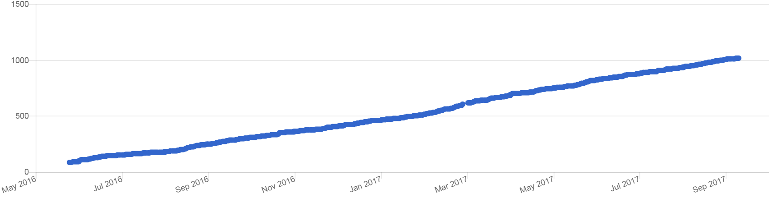
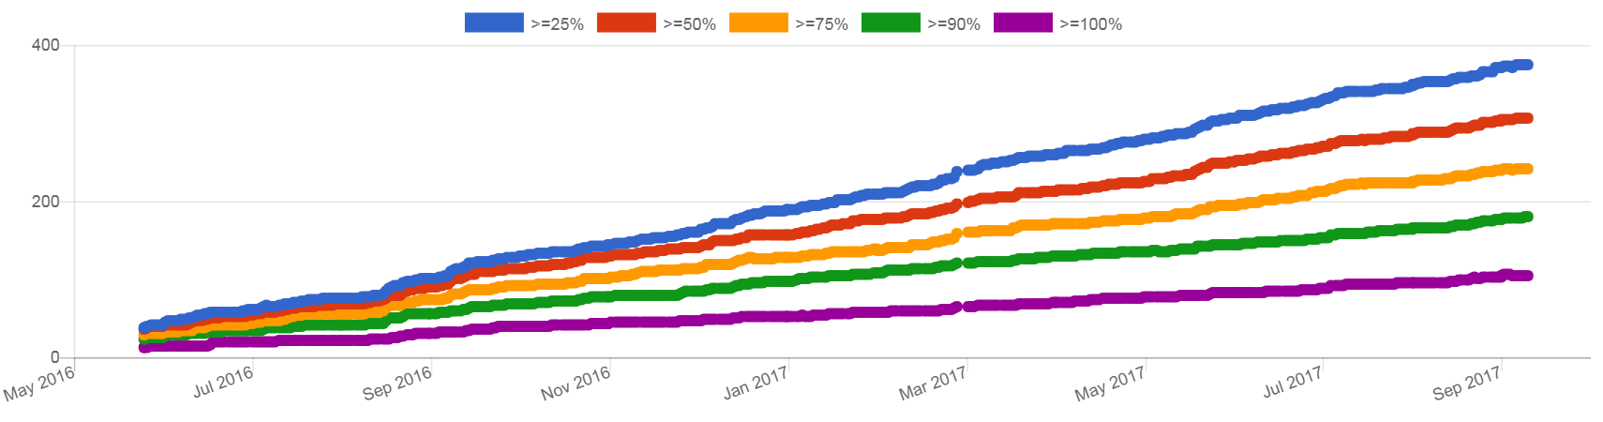
CII Best Practices Badge: Please get one!
If you’re developing OSS, please do get a badge
https://bestpractices.coreinfrastructure.org/
All
projects
Projects with non-trivial progress
Source: https://bestpractices.coreinfrastructure.org/project_stats
as of 2017-09-19
Notes:
This presentation has focused on the BadgeApp as an example.
However, if you’re involved in developing open source software, I encourage you to use the BadgeApp to get a CII best practices badge for your own open source software project. Here is the URL where you can start the process of getting a badge. As you can see from the graphs below, there are more and more projects that have started the badge process, and also more and more projects that have received a passing badge. We believe that OSS projects that implement best practices are more likely to produce better software, including more secure software, so pursuing a badge is an easy way for open source software projects to self improve.
If you’re considering using OSS, then again, look for a CII best practices badge. Projects with a CII best practices badge are actively pursuing doing the right things, and those are the kinds of projects you want to depend on.

Slide 18
Wrap-up
Your software will no doubt be different
Different requirements, technology stack, etc.
But that’s not the point – this is a worked example
Perfection impossible: Goal is to manage risk
Id & manage your risks (likelihood & impact) throughout lifecycle
Prevention (including hardening), detection, recovery
3rd party vulnerabilities can be rapidly detected & acted on
Gain agreement through an “assurance case”
So all understand what is/will be done (incl. limitations)
More/different always possible; agreement on “enough”
For more information on developing secure software, see “Secure Programming HOWTO”
https://www.dwheeler.com/secure-programs
It’s practical to make software “adequately secure”
But must plan for it. Plan for it & do it!

Slide 19
License & credits
Slides & narration released under the Creative Commons Attribution 3.0 Unported or later (CC-BY-3.0+) license https://creativecommons.org/licenses/by/3.0/
Music “Cycles” from Audionautix (Jason Shaw), CC-BY-3.0 Unported, http://audionautix.com
Image “Wizard Silhouette” by GDJ, created 2016-01-03. released to public domain under CC0. See: https://openclipart.org/detail/235806/wizard-silhouette
Thanks to the Linux Foundation’s Core Infrastructure Initiative (CII) for supporting the development of the “BadgeApp” (including its assurance case)
Assurance case details at https://github.com/coreinfrastructure/best-practices-badge/blob/master/doc/security.md

